Slide 1
Covid-19 Policy Making using Action Rule Mining
Titli Sarkar
Superv=or: Dr. Satya Katragadda
Dr. Vijay Raghavan

Slide 2
Problem Statement
An improved Recommendation System for Covid-19 government Policy Making using Action rules.
Action Rules:
Static + Flexible s - > Target
Antecedent Consequent
Change in Flexible Change in Target
Our analys= includes studying the impact of different factors on target variable like the following:
i> choice of flexible s,
ii> different thresholds,
iii> best combination of support, confidence and lift etc.

Slide 3
Data
Oxford Dataset: main_OxCGRTUS_timeseries_all.xlsx - Provided by Dr. Satya [1] , explanation about dataset [2], git repo [3].
s:
Indices for overall measures(4):
Aggregate data into a single number – (0 to 100) - reflects the level of the governments response
Measure of how many of the relevant indicators a government has acted upon, and to what degree.
government_response_index (all indicators)
stringency_index (all C indicators + H1 which records public information campaigns)
containment_health_index (all C and H indicators)
economic_support_index (all E indicators)
C (1 to 8) - containment and closure policies
E (1 to 2) - economic policies
H (1 to 8) - health system policies
Target:
confirmed_cases
confirmed_deaths
[1] https://drive.google.com/file/d/1CKx2t3vgxINwPPvY5uweeYLZSCdkjiM7/view?usp=sharing
[2] https://www.bsg.ox.ac.uk/sites/default/files/2021-05/BSG-WP-2020-034-v3.pdf
[3] OxCGRT/covid-policy-tracker

Slide 4
Data Preprocessing
Added s (3):
population density , https://www.stat=ta.com/stat=tics/183588/population-density-in-the-federal-states-of-the-us/
urban vs rural population, https://www.icip.iastate.edu/tables/population/urban-pct states%20we%20have%20used%202010%20urban%20population
hhs regions, https://www.hhs.gov/about/agencies/iea/regional-offices/index.html
Data Format:
Excel sheet, each sheet = one attribute
Data for Jan 1, 2020 – April 28, 2021 = 70 weeks
Data for 51 states
Preprocessing:
Antecedents - Weekly average across all states
Target variables – Cases per capita (for each state) = cases per week / population *100*100
where,
cases per week = weekly sum of |cumulative cases today - cumulative cases yesterday|

Slide 5
Data Preprocessing
Decide on Atributes:
Stable
week, state, region, population_density, urban_percentage
Flexible
Level 1: stringency_index, government_response_index, containment_health_index, economic_support_index
Level 2: Remove Level 1 attribues and use
C s (containment and closure policies)
H s (health system policies)

Slide 6
Discretization
 | Type | D=critized =s | Percentage | Actual =s | Measurements across all states
confirmed_cases | Target | high | 100 | 135.81 to 1254.23 | weekly average
confirmed_cases | Target | medium | 66 | 38.30 to 135.81
confirmed_cases | Target | low | 33 | 0.00 to 38.30
confirmed_deaths | Target | high | 100 | 2.25 to 43.63 | weekly average
confirmed_deaths | Target | medium | 66 | 0.67 to 2.25
confirmed_deaths | Target | low | 33 | 0.00 to 0.67
population_density | Stable | high | 100 | 174.47 to 1207.83 | Population density per capita
population_density | Stable | medium | 66 | 58.03 to 174.47
population_density | Stable | low | 33 | 1.28 to 58.03
urban_percentage | Stable | high | 100 | 73.75 to 95.00
urban_percentage | Stable | medium | 50 | 64.80 to 73.75
urban_percentage | Stable | low | 25 | 38.70 to 64.80
region | Stable | Region1_Boston |  | 'Connecticut', 'Maine', 'Massachusetts', 'New Hampshire', 'Rhode =land', 'Vermont'
region | Stable | Region2_NewYork |  | 'New Jersey', 'New York'
region | Stable | Region3_Philadelphia |  | 'Delaware', 'Maryland', 'Pennsylvania', 'Virginia', 'West Virginia'
region | Stable | Region4_Atlanta |  | 'Alabama', 'Florida', 'Georgia', 'Kentucky', 'M=s=sippi', 'North Carolina', 'South Carolina', 'Tennessee'
region | Stable | Region5_Chicago |  | 'Illino=', 'Indiana', 'Michigan', 'Minnesota', 'Ohio', 'W=consin'
region | Stable | Region6_Dallas |  | 'Arkansas', 'Lou=iana', 'New Mexico', 'Oklahoma', 'Texas'
region | Stable | Region7_KansasCity |  | 'Iowa', 'Kansas', 'M=souri', 'Nebraska'
region | Stable | Region8_Denver |  | 'Colorado', 'Montana', 'North Dakota', 'South Dakota', 'Utah', 'Wyoming'
region | Stable | Region9_SanFranc=co |  | 'Arizona', 'California', 'Hawaii', 'Nevada'
region | Stable | Region10_Seattle |  | 'Alaska', 'Idaho', 'Oregon', 'Washington'

Slide 7
Discretization
 | Type | D=critized =s | Percentage | Actual =s
stringency_index | Flexible | 4 | 80 | 59.91 to 68.52
stringency_index | Flexible | 3 | 60 | 53.97 to 59.91
stringency_index | Flexible | 2 | 40 | 43.42 to 53.97
stringency_index | Flexible | 1 | 20 | 0.00 to 43.42
stringency_index | Flexible
containment_health_index | Flexible | 5 | 100 | 65.48 to 79.66
containment_health_index | Flexible | 4 | 80 | 60.24 to 65.48
containment_health_index | Flexible | 3 | 60 | 55.72 to 60.24
containment_health_index | Flexible | 2 | 40 | 46.43 to 55.72
containment_health_index | Flexible | 1 | 20 | 0.00 to 46.43
economic_support_index | Flexible | 5 | 100 | 75.0 to 100.0
economic_support_index | Flexible | 4 | 80 | 62.5 to 75.0
economic_support_index | Flexible | 3 | 60 | 37.5 to 62.5
economic_support_index | Flexible | 2 | 40 | 25.0 to 37.5
economic_support_index | Flexible | 1 | 20 | 0.00 to 25.0
government_response_index | Flexible | 5 | 100 | 65.44 to 80.21
government_response_index | Flexible | 4 | 80 | 59.96 to 65.44
government_response_index | Flexible | 3 | 60 | 54.81 to 59.96
government_response_index | Flexible | 2 | 40 | 45.31 to 54.81
government_response_index | Flexible | 1 | 20 | 0.00 to 45.31

Slide 8
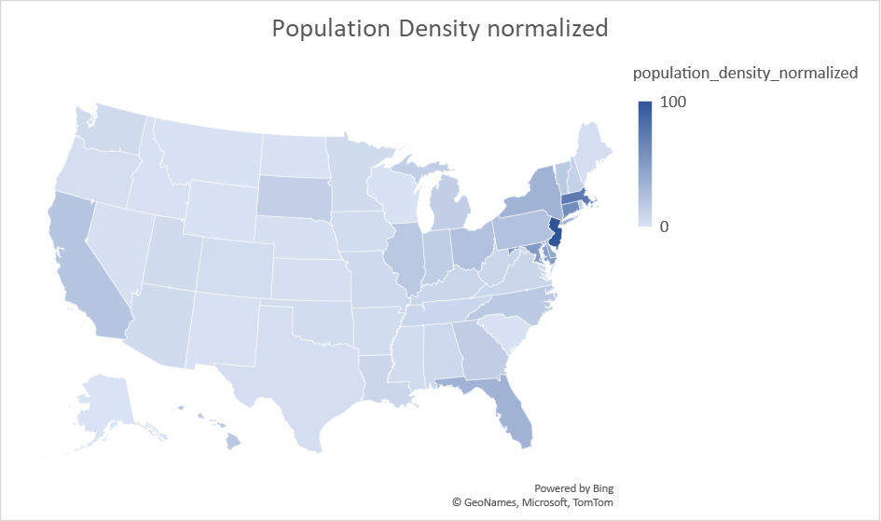
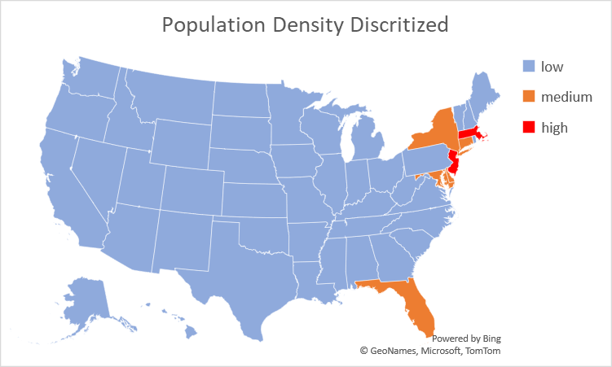
Plot of Population Density per square mile

Slide 9
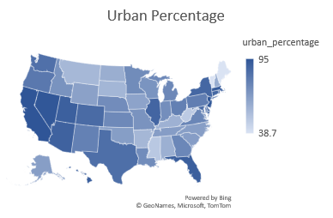
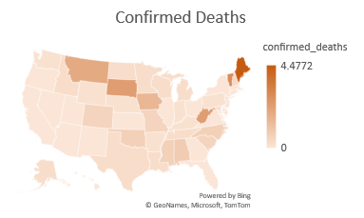
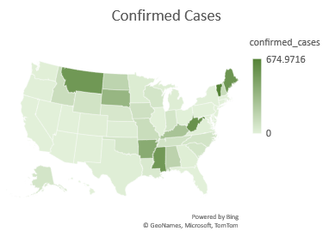
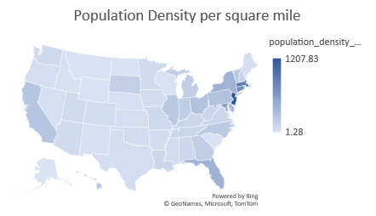
Data Plot

Slide 10
Global Comparison

Slide 11
Global Comparison

Slide 12
Plot

Slide 13
Plot

Slide 14
Various Govt. policies issued across all the states across the United States

Slide 15
Action Rules
Phase 1: Classification Rule Mining
= #of transactions that match both the antecedent and consequent of the given rule
= = ratio between #of transactions that satisfy the antecedent as well as the consequent to #of transactions that satisfy the antecedent
Phase 2: Generation of Action Rules

Slide 16
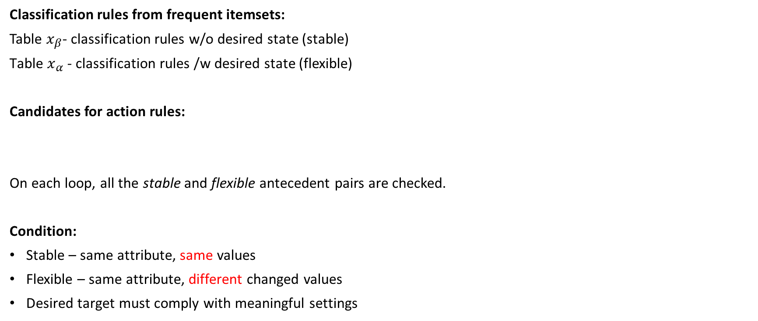
Action Rule Generation with Rule-based Approach
Classification rules from frequent itemsets:
Table $x_{β}$- classification rules w/o desired state (stable)
${\text{Table} x}_{α}$ - classification rules /w desired state (flexible)
Candidates for action rules:
On each loop, all the stable and flexible antecedent pairs are checked.
Condition:
Stable – same attribute, same values
Flexible – same attribute, different changed values
Desired target must comply with meaningful settings
Cartesian product
Classification Rule Pairs =

Slide 17
Speedup by Reduction Tree
Split table of all classification rules to multiple small tables
each stable -> one table
Elimination:
do not contain desired target =
do not have enough variability

Slide 18
Action Rules application
Framework: A python module for Action Rules - lucasSycora.
def runD=covery(conf, supp, level): # level = target =s
actionRD=covery = ActionRulesD=covery()
actionRD=covery.load_pandas(df)
actionRD=covery.fit(stable_s = ['region', 'population_density', 'urban_percentage'],
flexible_s = ['stringency_index',
'government_response_index',
'containment_health_index',
'economic_support_index'],
consequent = "confirmed_deaths",
conf=conf,
supp=supp,
desired_classes = [level],
#desired_changes = [["low", "high"]], ## change here
)
pretty_ar = actionRD=covery.get_pretty_action_rules()

Slide 19
Action Rules
confs = [10, 20, 30, 40, 50, 60, 70, 80, 90]
supps = [1, 2, 3, 4, 5, 6, 7, 8, 9, 10]
levels = ['low', 'medium', 'high']
for level in levels:
for conf in confs:
for supp in supps:
runD=covery(conf, supp, level)
low 10 1 Rules:155
low 20 1 Rules:155
low 30 1 Rules:145
low 40 1 Rules:103
low 50 1 Rules:78
low 60 1 Rules:53
low 70 1 Rules:24
medium 10 1 Rules:150
medium 10 2 Rules:7
medium 20 1 Rules:150
medium 20 2 Rules:7
medium 30 1 Rules:135
medium 30 2 Rules:7
medium 40 1 Rules:96
medium 40 2 Rules:7
medium 50 1 Rules:68
medium 50 2 Rules:6
medium 60 1 Rules:31
medium 70 1 Rules:3
high 10 1 Rules:155
high 10 2 Rules:6
high 20 1 Rules:155
high 20 2 Rules:6
high 30 1 Rules:142
high 30 2 Rules:6
high 40 1 Rules:97
high 40 2 Rules:6
high 50 1 Rules:80
high 50 2 Rules:5
high 60 1 Rules:54
high 70 1 Rules:25
Goal: confirmed_deaths => low
high -> low
Medium -> low

Slide 20
Example: Action Rules
Target:=low Conf:=70 Supp=1 #of Rules:=24
Rule 1: [[[['region', ('region4_atlanta',)]], [['containment_health_index', ('6', '1')]], ['confirmed_deaths', ['high', 'low']]],
[0.041, 0.018, 0.018], [0.729, 1.0, 0.729], 0.041]
Pretty Rule 1: 'region' = 'region4_atlanta’,
'containment_health_index' = '6' to '1’,
then 'confirmed_deaths' = 'high' to 'low’
with support: 0.018, confidence: 0.729 and uplift: 0.041.

Slide 21
Rules – confirmed deaths
4-index, target = low
'population_density' = 'low', 'containment_health_index' = '3' to '1', 'economic_support_index' = '2' to '1', 'stringency_index' = '3' to '1', 'government_response_index' = '3' to '1', then 'confirmed_deaths' = 'high' to 'low' with support: 0.08735294117647059, confidence: 0.5469613259668509 and uplift: 0.08735294117647059.
'urban_percentage' = 'medium', 'containment_health_index' = '3' to '1', 'stringency_index' = '3' to '1', 'government_response_index' = '3' to '1', then 'confirmed_deaths' = 'high' to 'low' with support: 0.052647058823529415, confidence: 0.5030674846625767 and uplift: 0.07235294117647059.
'population_density' = 'low', 'urban_percentage' = 'medium', 'containment_health_index' = '3' to '1', 'economic_support_index' = '2' to '1', 'stringency_index' = '3' to '1', 'government_response_index' = '3' to '1', then 'confirmed_deaths' = 'high' to 'low' with support: 0.04176470588235294, confidence: 0.6016949152542372 and uplift: 0.04176470588235294.
'urban_percentage' = 'high', 'containment_health_index' = '3' to '1', 'economic_support_index' = '2' to '1', 'stringency_index' = '3' to '1', then 'confirmed_deaths' = 'high' to 'low' with support: 0.046764705882352944, confidence: 0.5000244162084558 and uplift: 0.046476051720998.
'population_density’ = 'low', 'containment_health_index’ ='4' to '1', then 'confirmed_deaths’ = 'medium' to 'low' with support: 0.12764705882352942, confidence: 0.42956301788788454 and uplift: 0.13546237717054782.

Slide 22
Rules – confirmed deaths
4-index, target = high
If attribute 'population_density_discretized' is 'low', attribute 'economic_support_index_discretized' value '1' is changed to '2', attribute 'government_response_index_discretized' value '1' is changed to '3', then 'confirmed_deaths_discretized' value 'low' is changed to 'high' with support: 0.10676470588235294, confidence: 0.5276162790697675 and uplift: 0.06890047879616963.
If attribute 'population_density_discretized' is 'low', attribute 'urban_percentage_discretized' is 'medium', attribute 'containment_health_index_discretized' value '1' is changed to '3', attribute 'stringency_index_discretized' value '1' is changed to '3', then 'confirmed_deaths_discretized' value 'low' is changed to 'high' with support: 0.052647058823529415, confidence: 0.4927476949609746 and uplift: 0.02593620546810273.
If attribute 'population_density_discretized' is 'low', attribute 'containment_health_index_discretized' value '4' is changed to '3', attribute 'government_response_index_discretized' value '4' is changed to '3', then 'confirmed_deaths_discretized' value 'medium' is changed to 'high' with support: 0.12588235294117647, confidence: 0.18710024866029282 and uplift: -0.03788216560509555

Slide 23
Plots for C-index

Slide 24
C-index
Observations
Supp = 10, conf=90/80 -> #AssoR= 248 (deaths)
Deaths
Target = low | Supp = 10 (max), conf=60 -> #AR= 2
High, med, low = max conf 60, supp 10
Cases
Target = low | Supp = 5, conf=70(max) -> #AR= 3
Target = low | Supp = 12, conf=60 -> #AR= 8
Target = low | Supp = 10, conf=60 -> #AR= 13
But . . . opposite is happening !!!

Slide 25
Plots for H-index

Slide 26
H-index
Observations
Supp =10 (max) , conf=70/60 -> #AssoR=40 (deaths)
Deaths
Target = low | Supp = 5 (very low), conf= 70-> #AR= 6
Target = low | Supp = 14, conf= 40 (very low)-> #AR= 3
High, med, low = max conf , supp ,
Cases
Target = low | Supp = 5, conf=-> 70 #AR= 3
Target = low | Supp = 12, conf=50 -> #AR= 3
But . . . opposite is happening !!!

Slide 27
Conclusion
None of the response indices are strongly co-related with target variables.
Therefore, we could not generate any action rules with very high support and confidence.
Overall, the rules generated with moderately high support and confidence values makes sense in real world, means change in flexible attributes positively change values of target variables.

